Slide 1

Creating a solution for the user with minimal Rights to gather ad info
Mike Davis
About Me: Loves fun drives, a foodie, & an at home mixologist.
Twitter: @tekman2300
GitHub: https://github.com/tekman2300/SCCMNerd
Gather AD Username using email address

Slide 2
Gather/Download the AD files needed to perform this action from my Github
Edit GetUserInfo.ps1 Line item 10 @domain.com with your domain then save script
Copy the entire folder and files to your Site server file repository to be used later
Optional Steps but I did it for my environment. Head over to http://www.powertheshell.com/isesteroids/ to download this amazing tool. The page guides you through how to download and is well written out.
Once you have it loaded into your PS ISE then you can convert to an EXE
Click on the Tools —> Turn Code into EXE option just like in the screenshot below.
Once you save it then you can use the file as an exe instead of executing the ps1 file through a shell.
You can just use the PS file if not wanting to go through all those steps above. Now to how it works
Create a Package in SCCM with two separate programs. One for copying the files and one for execution of the program from software center. When creating the Copy Files package it should look like this on your command line.

Slide 3
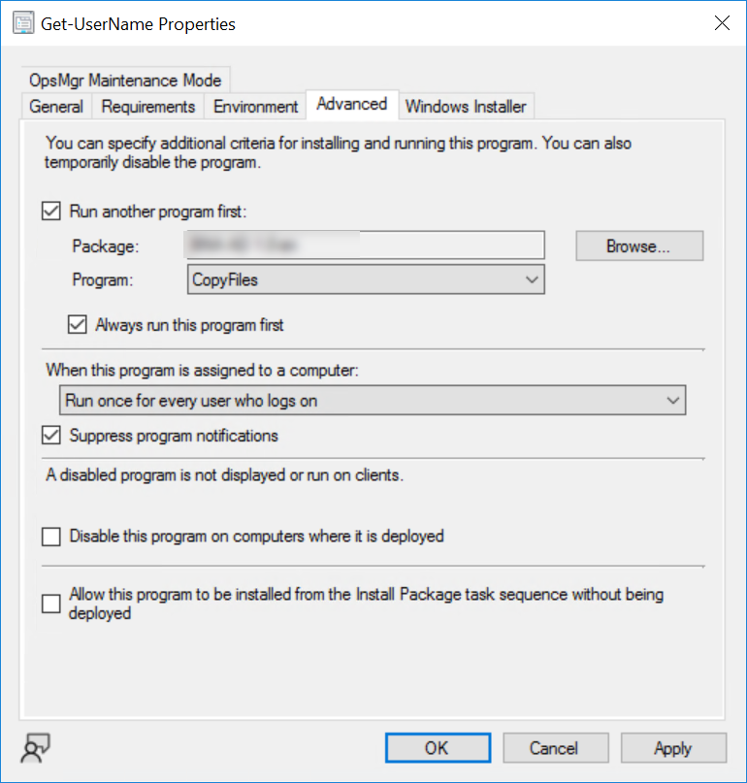
On the main program being used for software center, make sure you set the properties on the advanced tab like so to ensure the files are copied each time for new users.

Slide 4
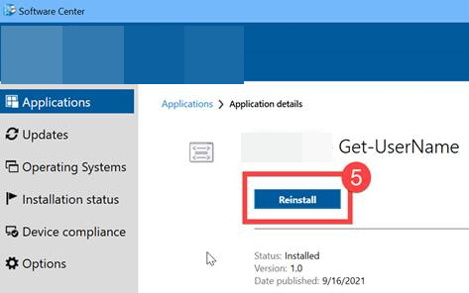
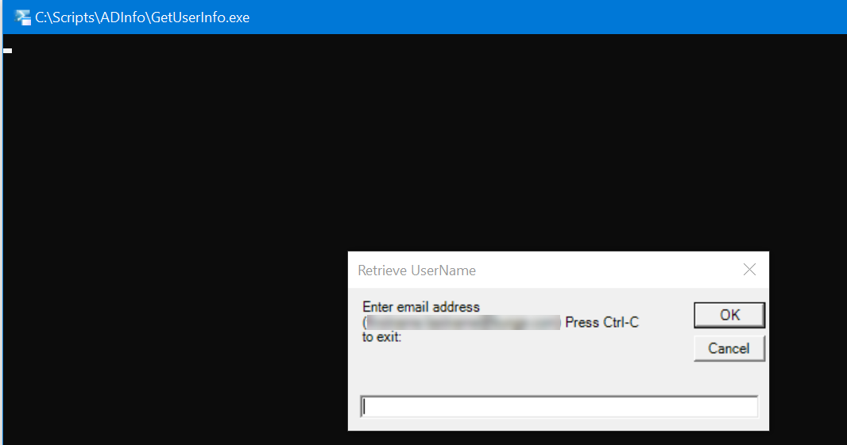
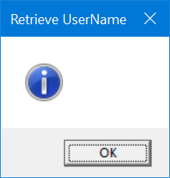
Once all those options are set, deploy your AD package to your user collection of your choice as available. This allows your user to run it as many times as they choose.
When being ran it looks like this and they just enter the email address and out comes a username ☺
If the email address is entered properly you will get the box to your right with a username that exist in the system, if not it will come back blank. You are able to right click and copy from the output box to a notepad or program of your choosing.

